Slide 1

User Interface Design
Zyad Rusdi

Slide 2
INTRODUCTION
Interface Disain adalah proses mendefinisikan bagaimana sistem akan berinteraksi dengan entitas eksternal.
Disain system interfaces mendefinisikan bagaimana sistem bertukar informasi dengan sistem lain..
Antarmuka pengguna mencakup tiga bagian dasar:
Mekanisme Navigasi - cara pengguna memberi tahu sistem apa yang harus dilakukan.
Mekanisme masukan - cara sistem menangkap informasi.
Mekanisme keluaran - cara sistem memberikan informasi kepada pengguna atau sistem lain.
Antarmuka pengguna grafis (GUI) menggunakan jendela, menu, ikon, dll., Dan merupakan jenis antarmuka pengguna yang paling umum.

Slide 3
PRINCIPLES FOR USER INTERFACE DESIGN
Desain antarmuka pengguna adalah seni.
Sasarannya adalah membuat antarmuka yang enak dipandang dan mudah digunakan, sekaligus meminimalkan upaya pengguna.

Slide 4
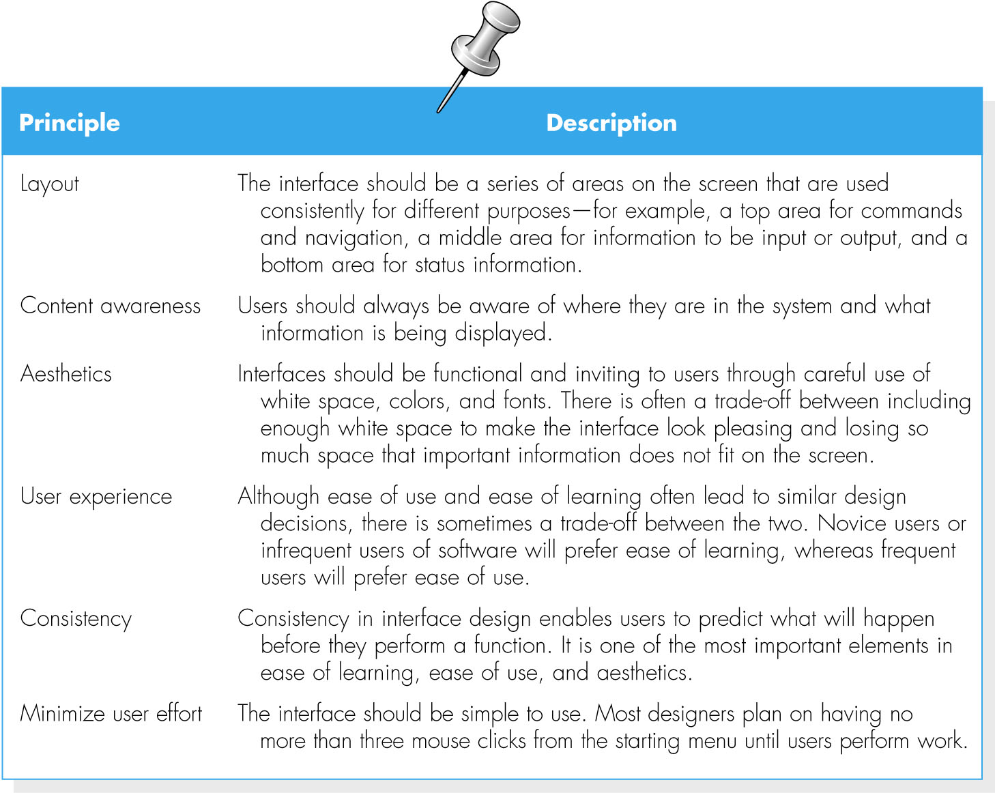
(cont’d)

Slide 5
Layout
Tata letak mengacu pada pengaturan area layar dan dokumen untuk tujuan yang berbeda dan menggunakan area ini secara konsisten di seluruh antarmuka pengguna.
Layar sering kali dibagi menjadi tiga area:
Area atas memberi pengguna cara untuk menavigasi melalui sistem;
Area tengah dan terbesar adalah untuk pajangan karya pengguna; dan
Area bawah berisi informasi status tentang yang dilakukan pengguna.
Area dan informasi di dalam area harus memiliki aliran intuitif alami untuk meminimalkan pergerakan pengguna dari satu area ke area berikutnya.
Idealnya, area tersebut akan tetap konsisten
ukuran,
bentuk,
penempatan formulir, dan
laporan yang digunakan untuk menyajikannya.

Slide 6
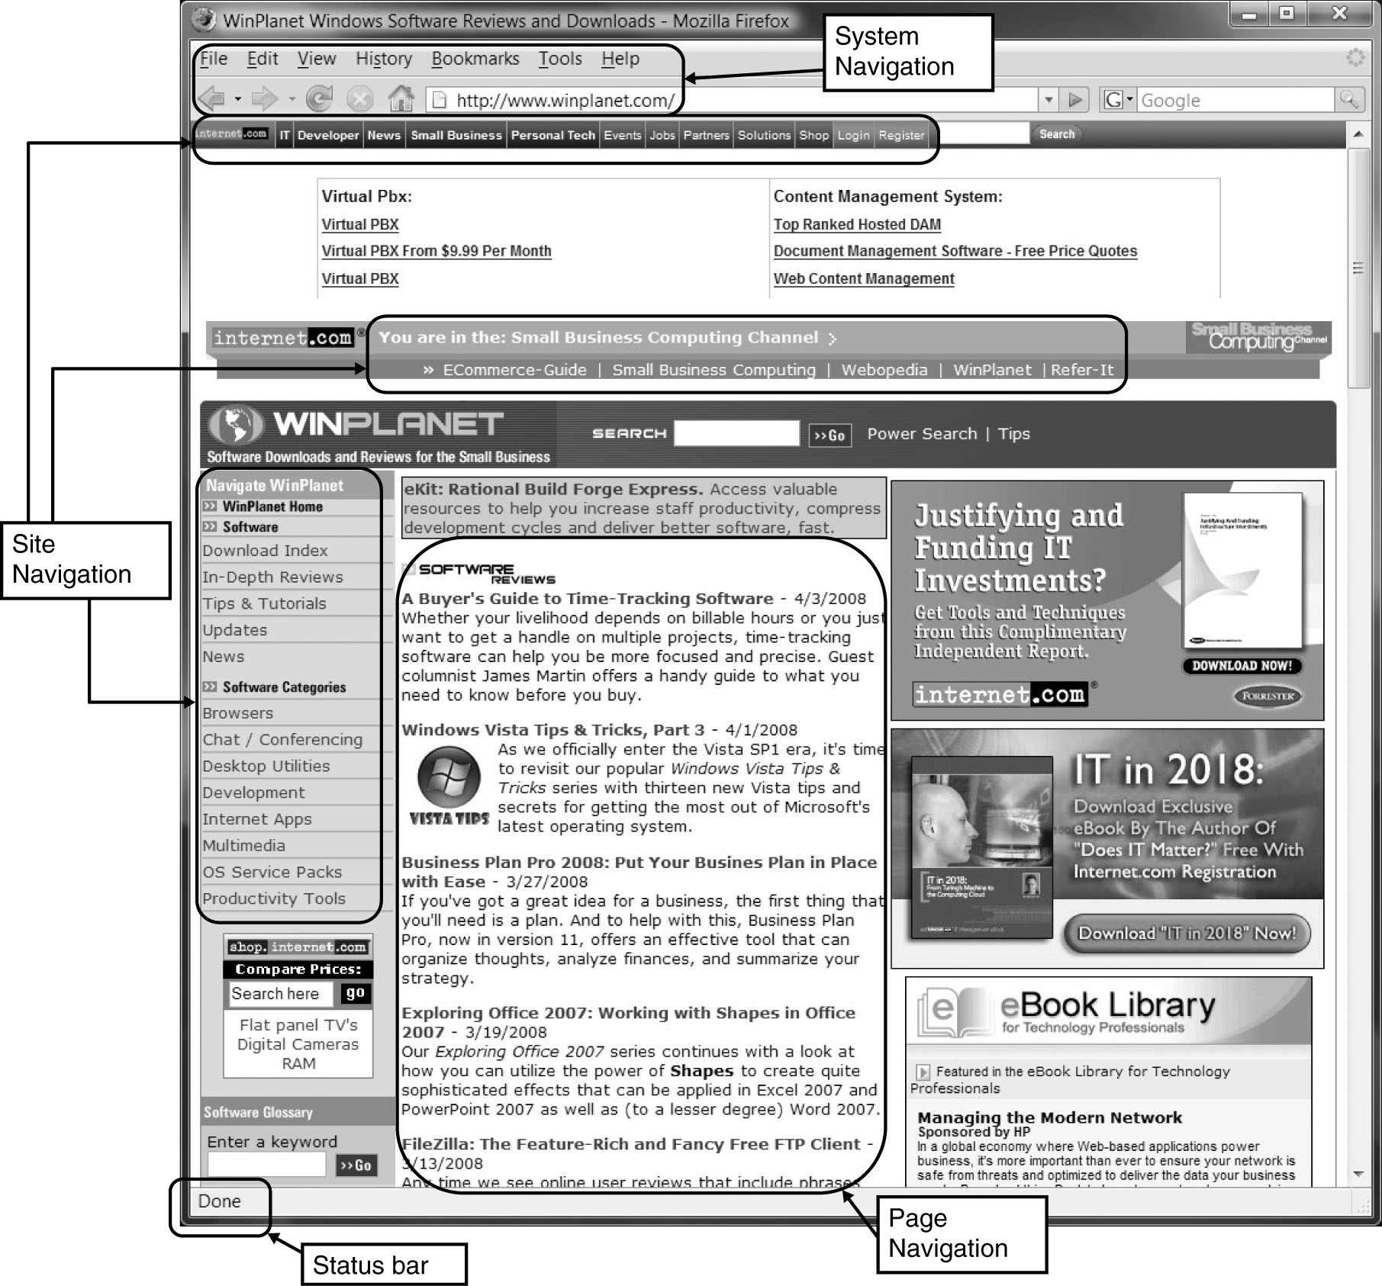
(cont’d)
Web page layout with multiple navigation areas

Slide 7
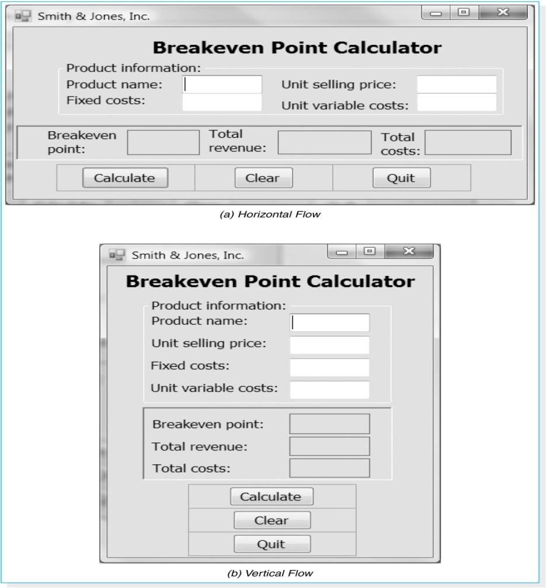
(cont’d)
The flow between sections should also be consistent.

Slide 8
Content Awareness
Content awareness mengacu pada kemampuan antarmuka untuk membuat pengguna mengetahui informasi yang dikandungnya.
Semua antarmuka harus memiliki judul.
Menu harus menunjukkan di mana pengguna berada dan dari mana asal pengguna untuk sampai ke sana.
Semua area harus jelas dan ditentukan dengan baik.
Content awareness juga berlaku untuk Field dan Field label di setiap area, dan informasi yang berisi formulir atau laporan.

Slide 9
Aesthetics/Estetika
Estetika mengacu pada desain antarmuka yang enak dipandang.
Antarmuka harus fungsional dan menarik untuk digunakan.
Secara umum, semua formulir dan laporan membutuhkan ruang kosong dalam jumlah tertentu.
Desain teks juga penting.
Font dan ukuran font
Warna dan pola

Slide 10
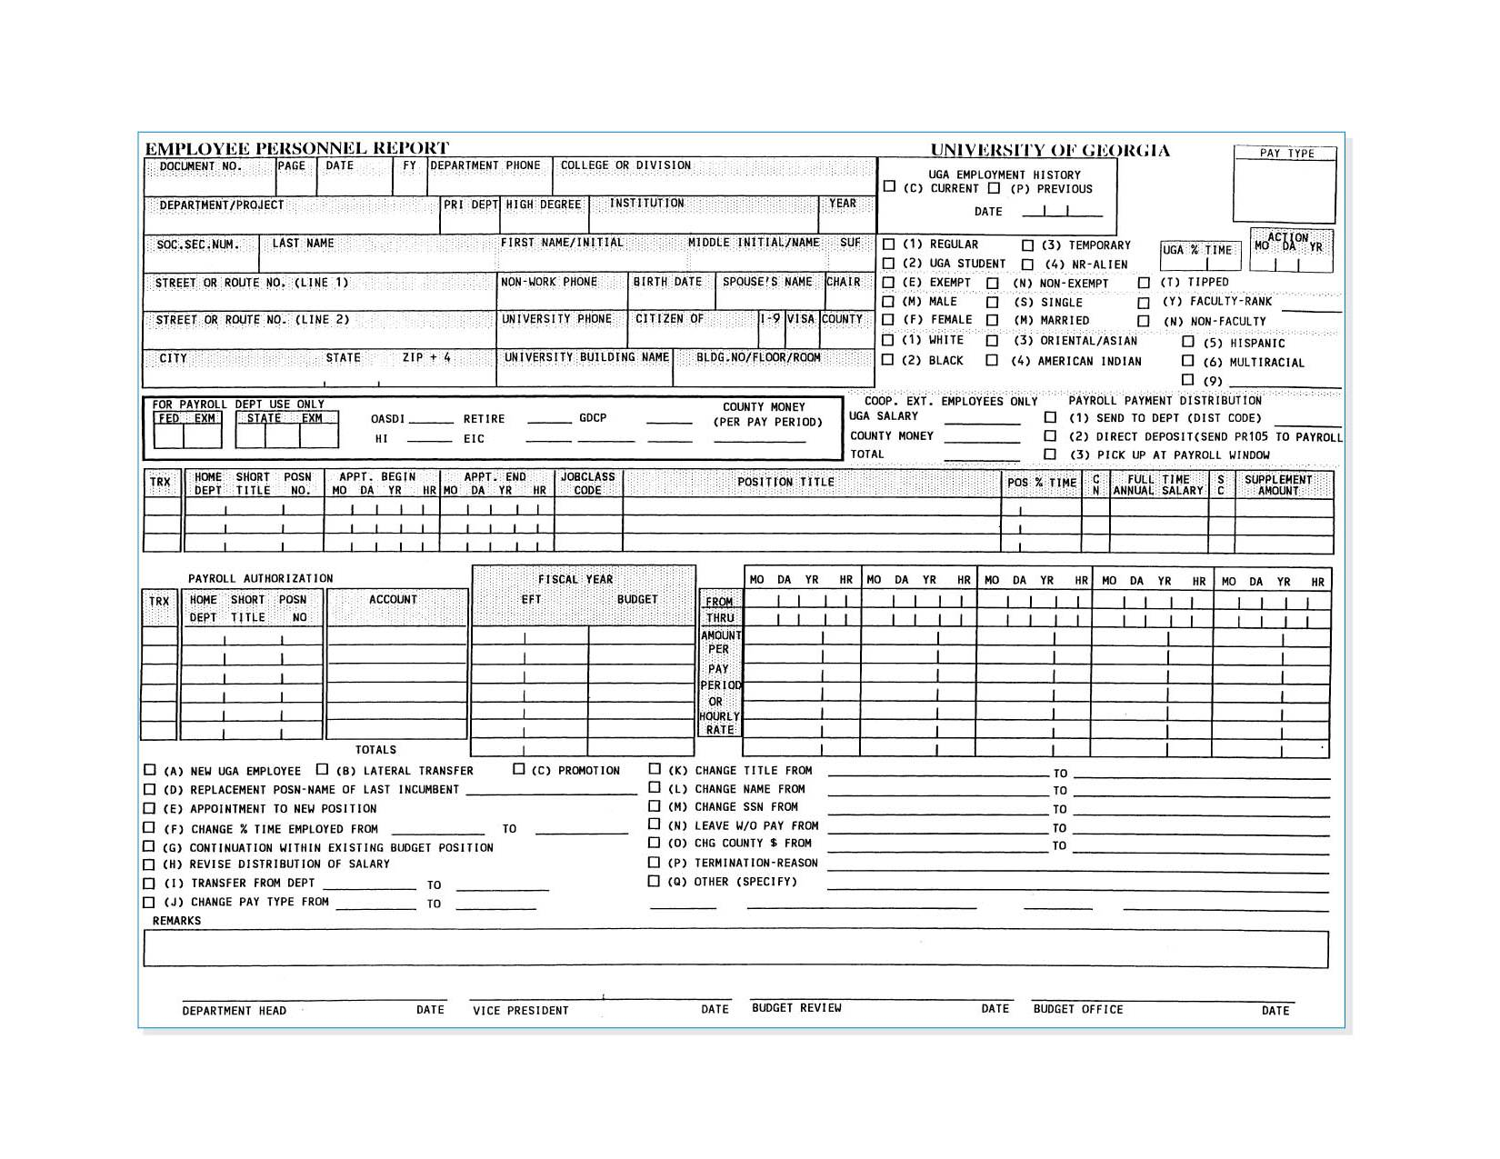
(cont’d)
An example of form with high density

Slide 11
User Experience
User experience mengacu pada merancang antarmuka pengguna dengan mempertimbangkan tingkat pengalaman komputer pengguna.
Novice/Pemula users memperhatikan easy of learning.
Expert users Memperhatikan easy of use.
Seringkali, kedua tujuan tersebut saling melengkapi dan mengarah pada keputusan desain yang serupa, tetapi terkadang ada trade-off.

Slide 12
Consistency
Konsistensi biasanya mengacu pada antarmuka dalam satu sistem komputer, sehingga semua bagian sistem yang sama bekerja dengan cara yang sama. Idealnya, bagaimanapun, sistem tersebut juga harus konsisten dengan sistem komputer lain dalam organisasi.
Konsistensi memungkinkan pengguna untuk memprediksi apa yang akan terjadi, dan mengurangi jumlah pembelajaran.
Konsistensi terjadi di berbagai tingkatan.
Kontrol navigasi;
Terminologi;
Laporan dan desain formulir.

Slide 13
Minimize User Effort
Meminimalkan upaya pengguna berarti menggunakan sesedikit mungkin klik mouse atau penekanan tombol untuk berpindah dari satu bagian sistem ke bagian lain.
Aturan tiga klik
Pengguna harus dapat beralih dari menu awal atau utama sistem ke informasi atau tindakan yang mereka inginkan tidak lebih dari tiga klik mouse atau tiga kali penekanan tombol.

Slide 14
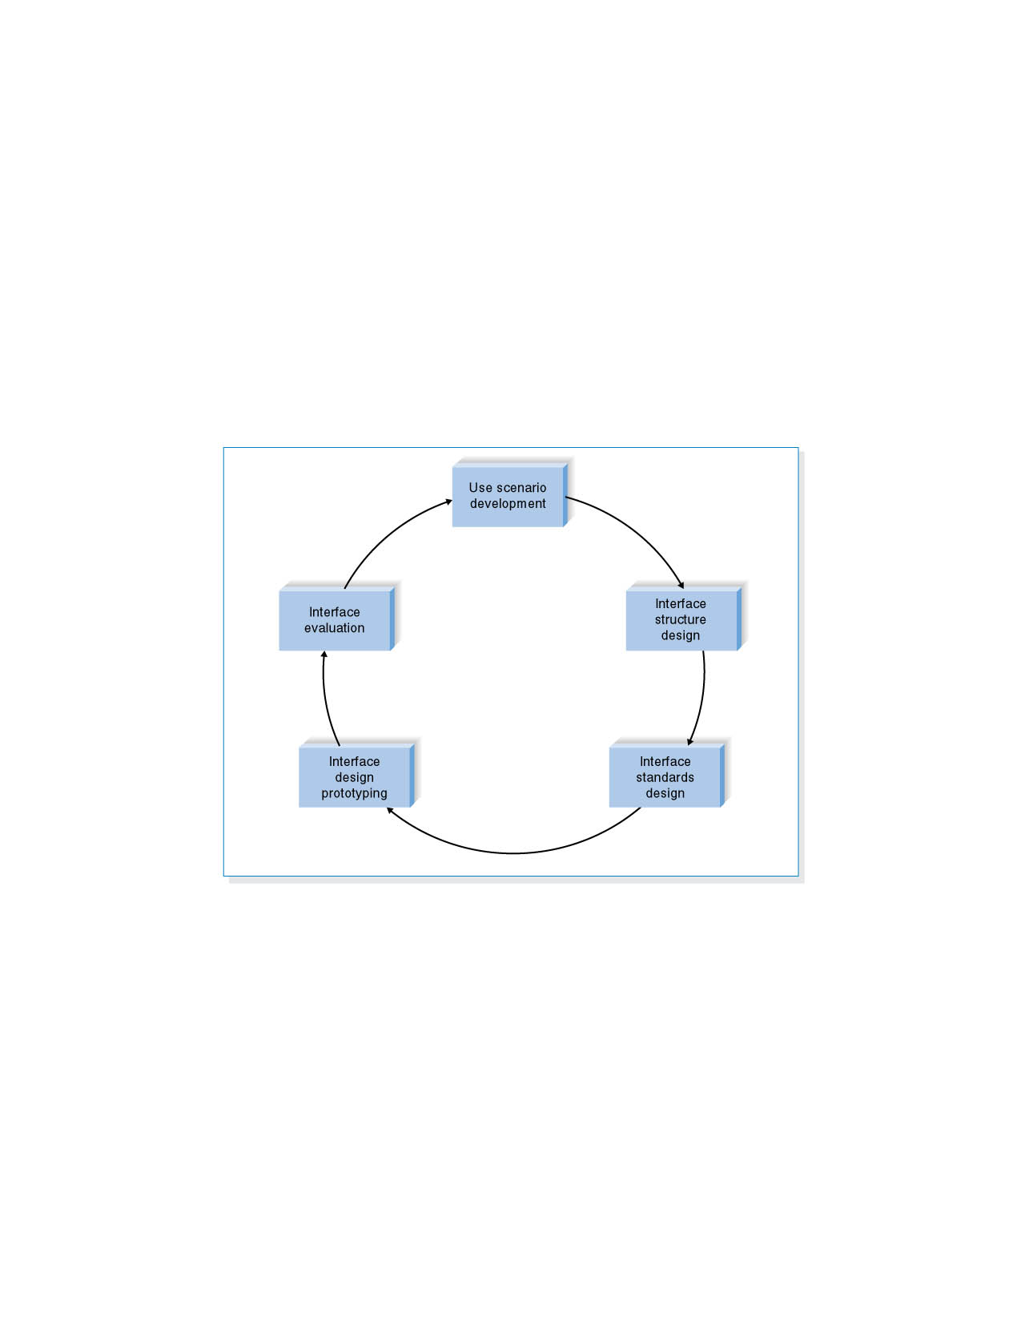
USER INTERFACE DESIGN PROCESS
User interface design is a five-step process that is iterative.

Slide 15
Use Scenario Development
A use scenario is an outline of steps that user s perform to accomplish some part of their work.
Use scenarios are presented in a simple narrative description that is tied to the DFD.

Slide 16
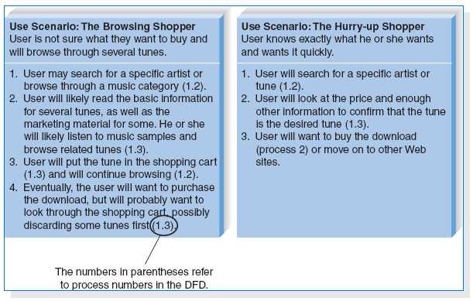
(cont’d)
Examples of use scenarios

Slide 17
Interface Structure Design
The interface structure design defines the basic components of the interface and how they work together to provide functionality to users.
An interface structure diagram (ISD) is used to show how all screens, forms, and reports are related and how the user moves from one to another.
An ISD is similar to a DFD in that it uses boxes and lines to show the structure. However, unlike DFDs, there are no commonly used rules or standards for ISDs.
The basic structure of the interface follows the basic structure of the business process itself as defined in the process model.

Slide 18
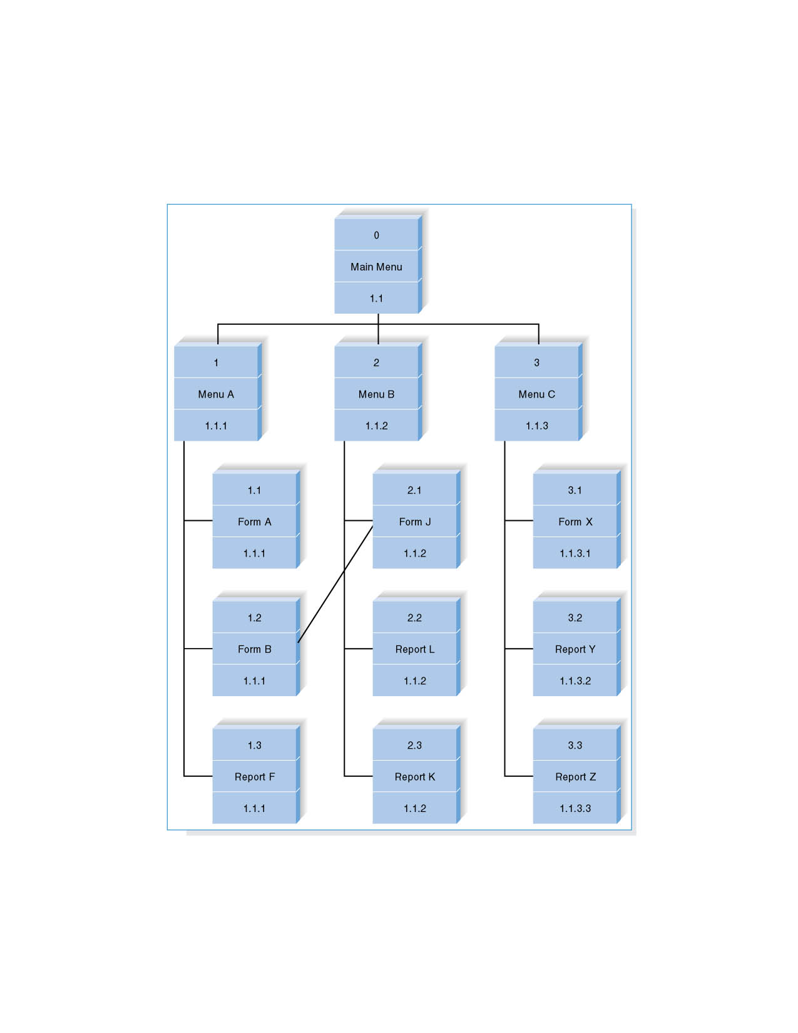
(cont’d)
Interface Structure Diagram Example

Slide 19
Interface Standards Design
The interface standards are the basic design elements that are common across the individual screens, forms, and reports within the system.
An interface metaphor is a concept from the real world that is used as a model for the computer system.
E.g., Quicken uses a checkbook metaphor.
The interface template defines the general appearance of all screens and the paper-based forms and reports.

Slide 20
(cont’d)
The template specifies the names that the interface will use for the major interface objects, the fundamental building blocks of the system.
The template gives names to the most commonly used interface actions.
The interface objects and actions, and also their status, may be represented by interface icons.

Slide 21
Interface Design Prototyping
An interface design prototype is a mock-up or a simulation of a computer screen, form, or report.
Common approaches to interface design prototyping:
Storyboards
HTML prototypes
Language prototypes.

Slide 22
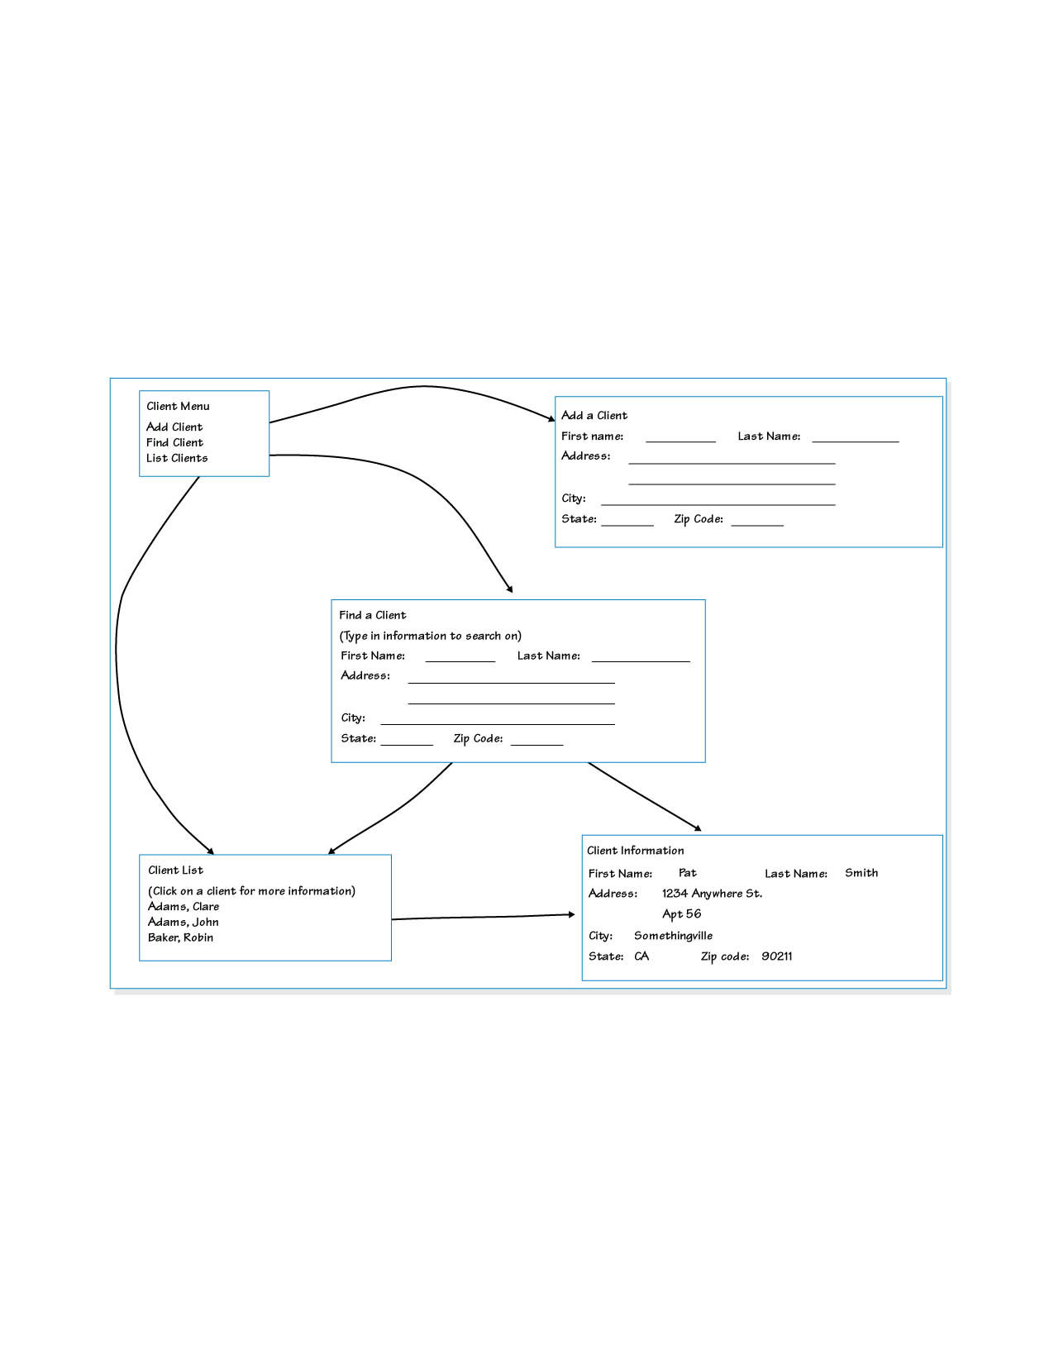
Storyboard
The storyboard shows hand-drawn pictures of screens.

Slide 23
HTML Prototype
An HTML prototype is built with the use of Web pages created in HTML (hypertext mark-up language).
The designer uses HTML to create a series of Web pages that show the fundamental parts of the system.

Slide 24
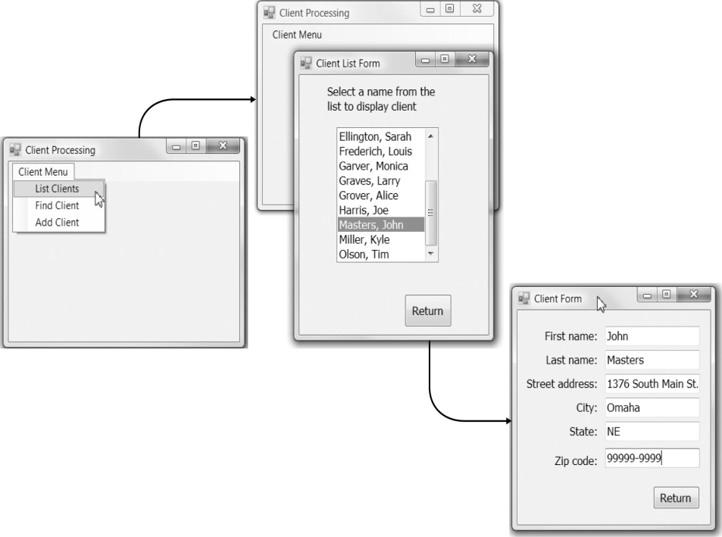
Language Prototype
A language prototype is an interface design prototype built in the actual language or by the actual that will be used to build the system.
An example of language prototype.

Slide 25
Interface Evaluation
The objective of interface evaluation is to understand how to improve the interface design.
There are four common approaches to interface evaluation.
1. Heuristic evaluation - Compare the interface to a checklist of design principles.
2. Walk-through evaluation - It is a meeting conducted with the users to walk through the interface.
3. Interactive evaluation - Users try out the interface.
4. Formal usability testing - It is a formal testing process to understand how usable the interface is.

Slide 26
NAVIGATION DESIGN
Basic Principles
- Analysts usually must assume that users have not read the manual, have not attended training, and do not have external help readily at hand.
- All controls should be clear and understandable and placed in an intuitive location on the screen.

Slide 27
(cont’d)
Prevent Mistakes - The first of principle of designing navigation control is to prevent users from making mistakes.
Labeling commands appropriately and limiting choices.
Confirming with the user that the actions are difficult or impossible to undo.
Simplify Recovery from Mistakes – making “undo” buttons whenever possible.
Use Consistent Grammar Order – Windows application uses an object-action grammar order.

Slide 28
Types of Navigation Control
There are three basic software approaches for defining user commands:
- Languages: command language and natural language.
- Menus: A menu presents the user with a list of choices.
- Direct Manipulation: With direct manipulation, the user enters commands by working directly with interface objects.

Slide 29
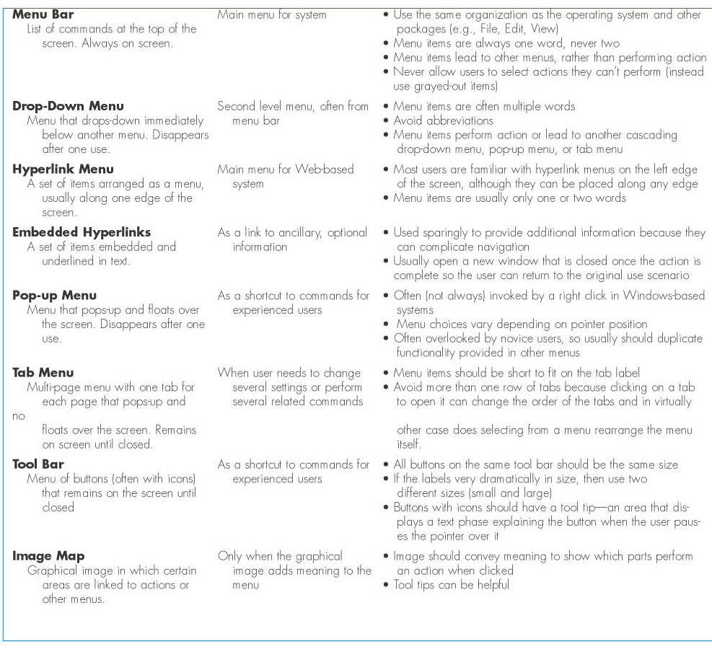
Types of Menus

Slide 30
Messages
Messages are the way in which the system responds to a user and informs the user of the status of the interaction.
Messages should be clear, concise, and complete.
All messages should be grammatically correct and free of jargon and abbreviations (unless they are the users’ ones).
Avoid negatives and humor.

Slide 31
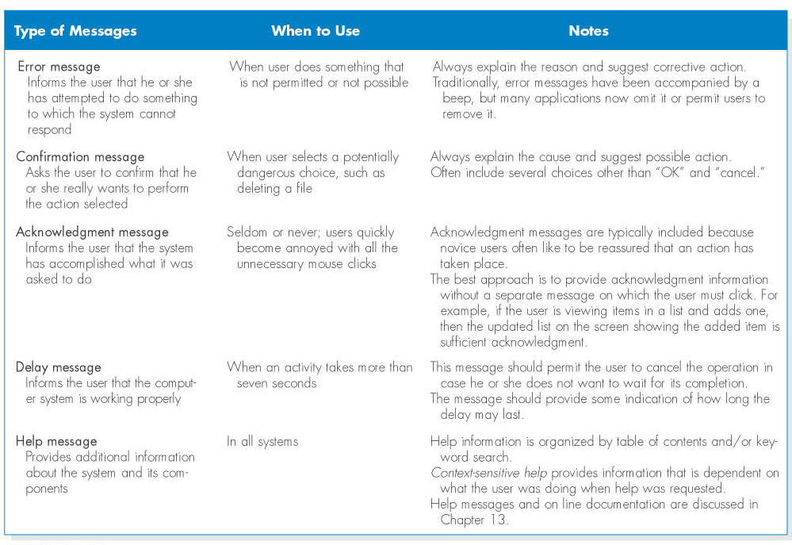
(cont’d)
Types of messages

Slide 32
INPUT DESIGN
Input mechanisms facilitate the entry of data into the computer system.
Input design means designing the screen used to enter information and forms on which the users write and type information.

Slide 33
Basic Principles
The goal of input design is to capture accurate information for the system simply and easily.

Slide 34
Use Online and Batch Processing Appropriately
There are two general formats for entering inputs into a computer system: online processing and batch processing.
Online processing: each input item is entered into the system immediately.
Batch processing: all the inputs collected over some period are gathered together and entered into the system at one time in a batch.
Batch processing simplifies data communications and cuts communications costs.

Slide 35
Capture Data at the Source
The most important principle of input design is to capture the data in an electronic format at the original source.
It reduces duplication work, reduces, processing time, decreases the cost, decreases the probability of error.

Slide 36
(cont’d)
Source data automation refers to using special hardware devices to automatically capture data without requiring anyone to type it.
Source data automation technologies:
bar code readers
optical character recognition
magnetic stripe readers
smart cards
RFID (radio frequency identification) tags
the Web.

Slide 37
Minimize Keystrokes
Keystrokes cost time and money.
The system should never ask for information that can be obtained in another way (e.g., by retrieving it from a database).
The system should not require a user to type information that can be selected from a list.
The frequent values should be used as the default value for the data.

Slide 38
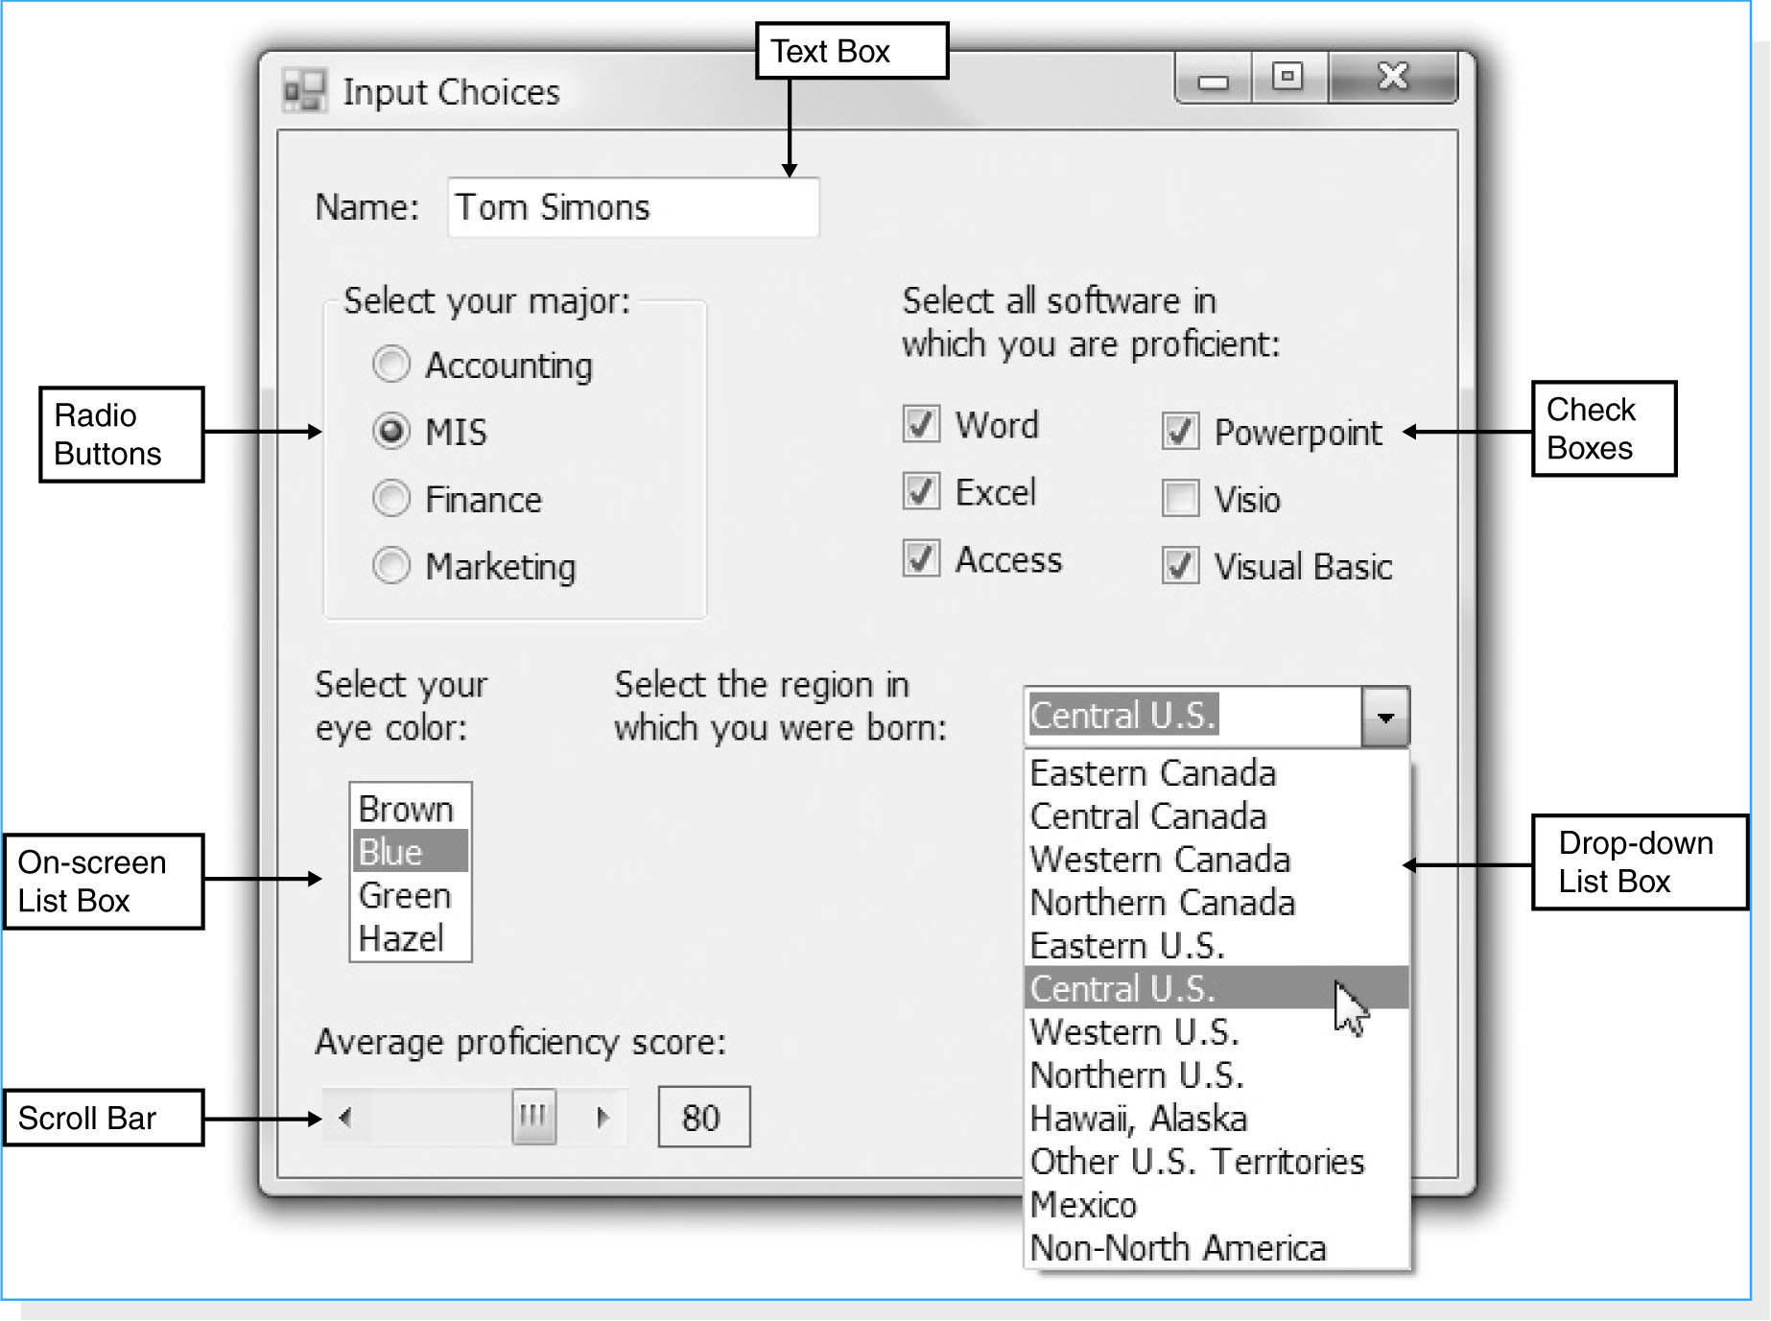
Types of Inputs
There are many different types of inputs, in the same way that there are many different types of fields.

Slide 39
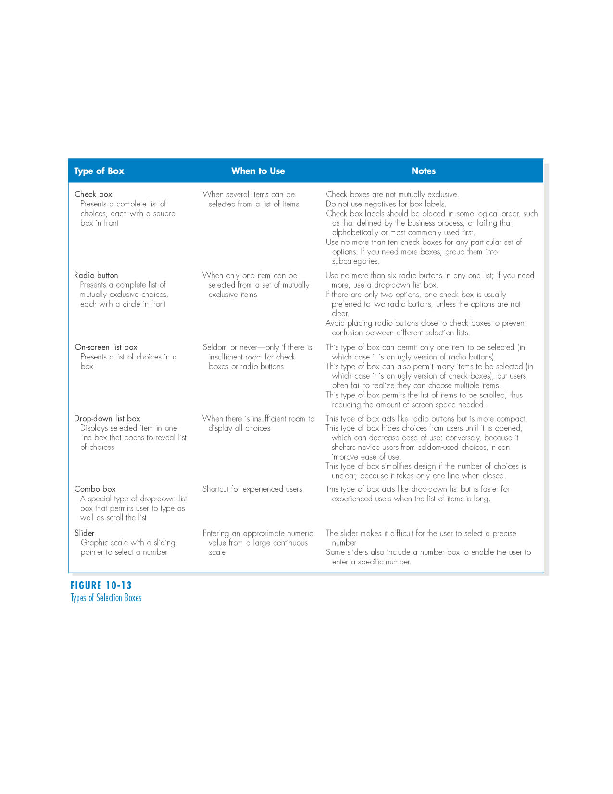
(cont’d)
There are many types of selection boxes

Slide 40
Input Validation
All data entered into the system must be validated in order to ensure accuracy.
Input validation (also called edit checks) can take many forms

Slide 41
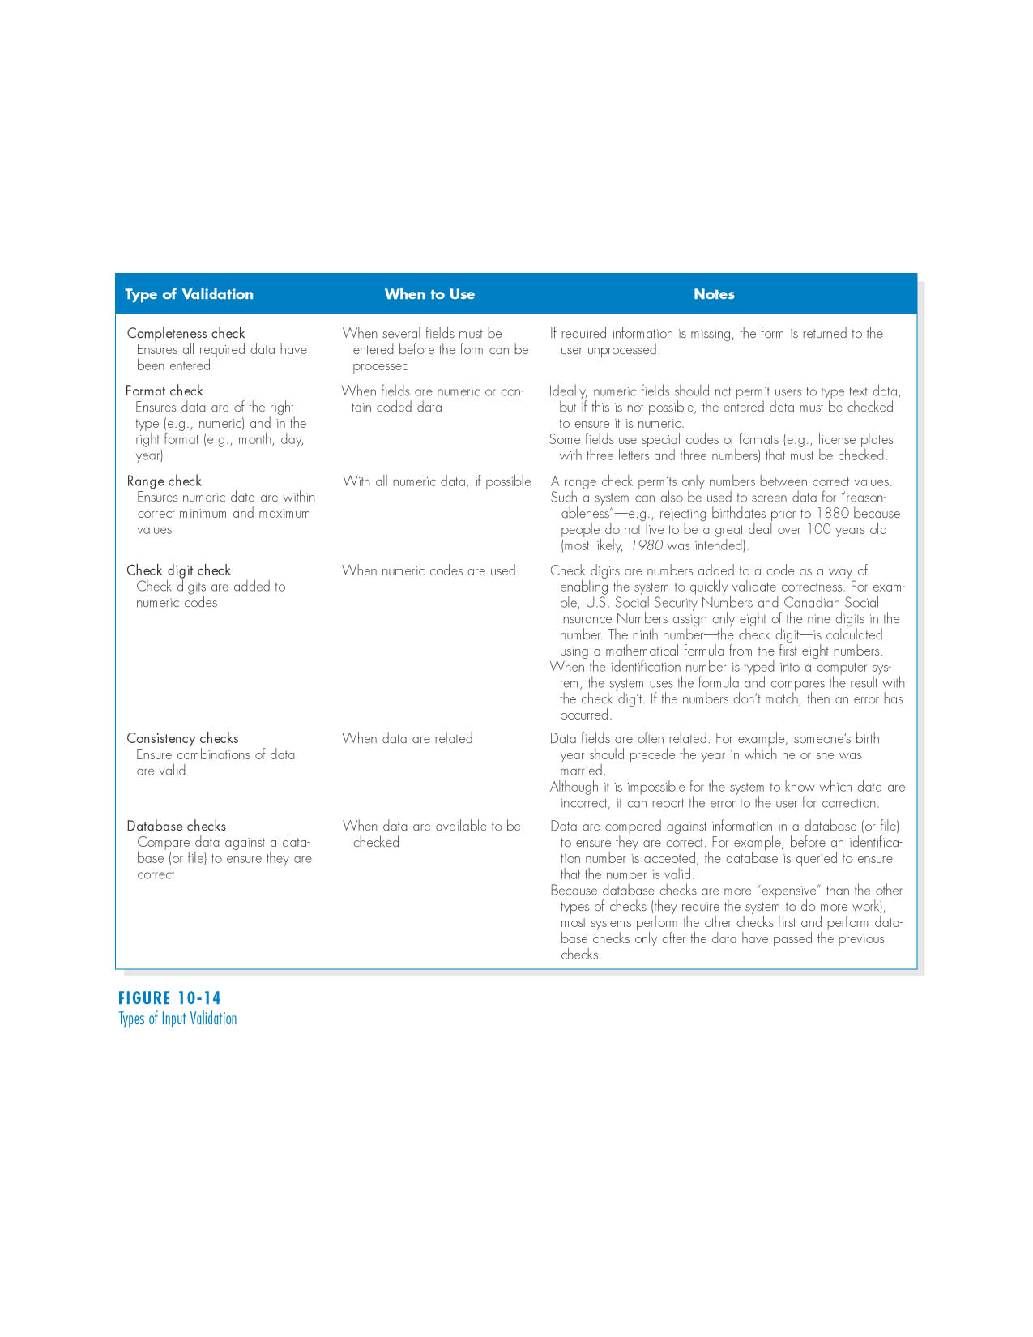
(cont’d)
There are six different types of validation checks:

Slide 42
OUTPUT DESIGN
Outputs are the reports that the system produces, whether on the screen, on paper, or in other media, such as the Web.
Outputs are the most visible part of any system.

Slide 43
Basic Principles
The goal of the output mechanism is to present information to users so that they can accurately understand it with the least effort.
Understand report usage – the first principle in designing reports is to understand how they are used.
Manage information load – the goal of a well-designed report is to provide all needed information without information overload.
Minimize bias – no analyst sets out to design a biased report.

Slide 44
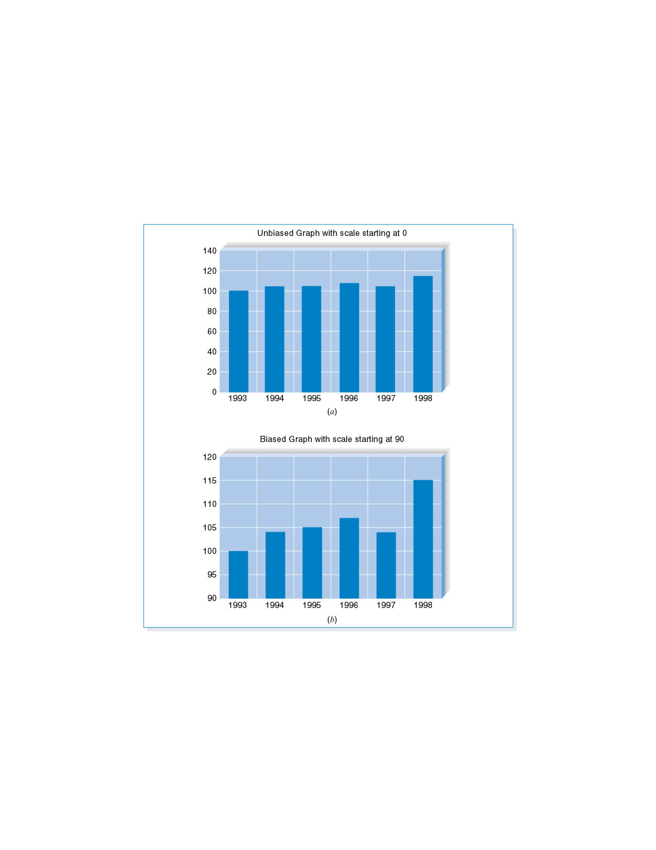
(cont’d)
Example of bias: Bias in graphs.

Slide 45
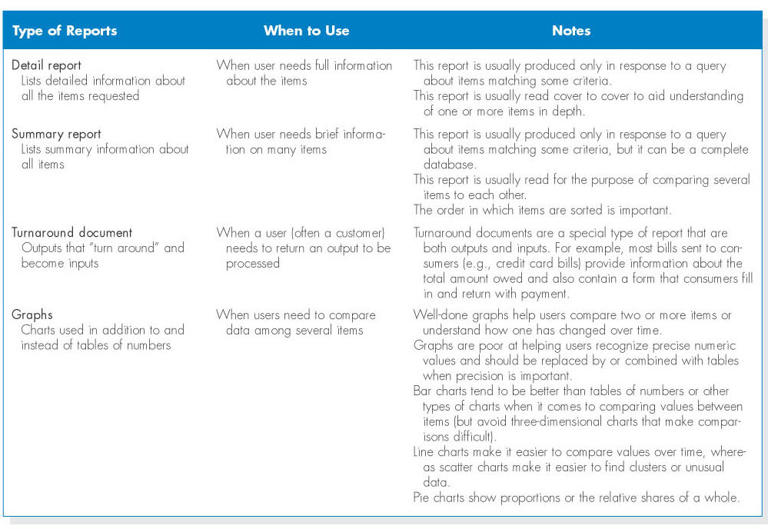
Types of Outputs

Slide 46
Media
The two dominant media of reports are paper and electronic.
Paper is the more traditional medium and is relatively permanent, easy to use, highly portable, and accessible in most situations.
However, paper reports are expensive.
Many organizations are moving to electronic production of reports.

Slide 47
SUMMARY
User interface design principles
- Layout, content awareness, aesthetics, user experience, consistency, minimize user effort.
The user interface design process
- Use scenario development, interface structure design, interface standards design, interface design prototyping, and interface evaluation.

